Slide 1

Laptop Price Predictor
Project by: code squad
Guided by: Sayanti Manna

Slide 2
Contents
1:Problem statement
2:Project overview
3:why do we need this?
4:How it will help others
5:solution
7:Result
6:How it is unique
Presentation Title

Slide 3

Problem statement
We will make a project for Laptop price prediction. The problem statement is that if any user wants to buy a laptop then our application should be compatible to provide a tentative price of laptop according to the user configurations .
Although it looks like a simple project or just developing a model, the dataset we have is and needs lots of feature engineering, and preprocessing that will drive your interest in developing this project.

Slide 4

Project overview
The project involves data collection from diverse laptops, encompassing specifications such as processor type, RAM size, storage capacity, display features, and more. This dataset will be used to train a machine learning model, likely utilizing regression techniques, to establish relationships between these features and laptop prices.
The goal is to create a reliable tool that can assist consumers, retailers, or manufacturers in estimating laptop prices based on their technical specifications. The model's performance will be evaluated through testing and validation to ensure accurate predictions in real-world scenarios.

Slide 5
“A laptop price predictor can help consumers make informed decisions by anticipating potential price changes, allowing them to time their purchases for better deals. It also aids sellers in setting competitive prices based on market trends, fostering a more efficient and transparent marketplace..”
Why do we need this?

Slide 6



How it will help others
*Informed Purchases:* Helps users make informed laptop purchases.
*Budget Planning:* Assists in budgeting for laptop expenses.
*Timing Purchases:* Enables strategic timing for cost-effective buys.
*Comparison Shopping:* Facilitates price comparisons across retailers.
*Market Trends Awareness:* Keeps users updated on market trends.
*Avoiding Overpayment:* Prevents overpaying for laptops.
*Technology Planning:* Aids in planning upgrades for optimal value.

Slide 7





Our Solution
Feature Selection:
Data Cleaning :
Model Selection:
Hyper parameter Tuning:
Evaluation Metrics:
Select appropriate evaluation metrics such as Mean Absolute Error (MAE) or Root Mean Squared Error (RMSE) to measure the model's accuracy.
Identify and select relevant features that significantly influence laptop prices. Consider specifications like processor speed etc.
Address missing or inconsistent data to ensure the quality of the dataset. Perform preprocessing steps like normalization and scaling to standardize the data for better model performance
Choose an appropriate machine learning model for regression, considering the nature of the data.
Optimize the hyperparameters of the chosen model to improve its accuracy. Use techniques like grid search or random search to find the combination that yields the best results.

Slide 8
What Makes Our Concept unique
Considers a wide range of factors beyond specs, including user reviews and brand reputation.
Constantly updates with the latest market trends and pricing information.
Our predictor leverages cutting-edge ML algorithms for precise price predictions.
Tailors predictions based on individual user preferences and requirements.
Proven track record of accurate past predictions, enhancing user confidence.

Slide 9
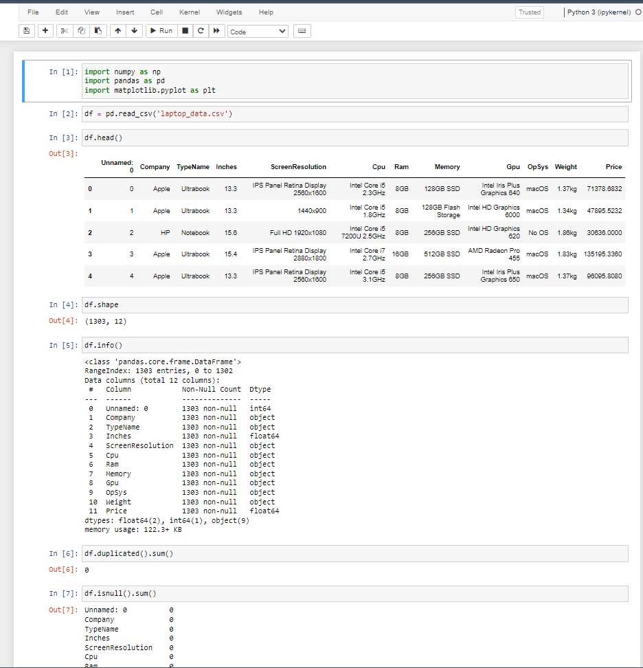
Result

Slide 10
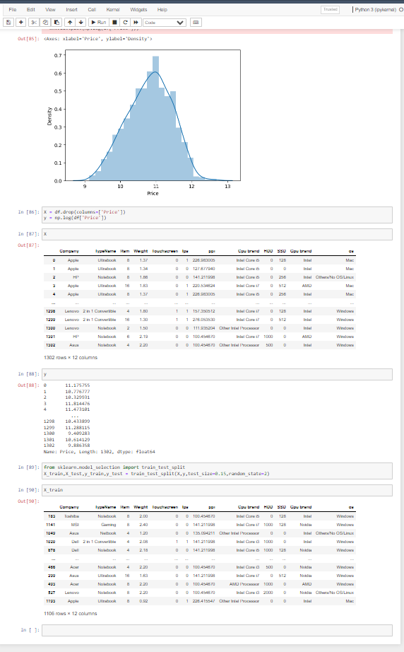


Result (contd.)

Slide 11




Thank you
Credit goes to >
Sayanti Manna
Arpita Roy
YouTube
Google

